Slide 1

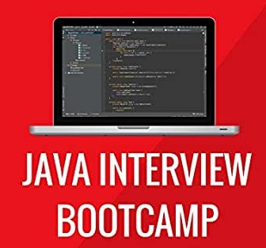
JAVA Java Interview boot camp Core concepts
Lecture 20
CHAPTER 33
Method References

Slide 2
Method references
(More Compact Lambdas!)

Slide 3
Today’s Agenda
Method References
Introduction To Method Reference
Types Of Method Reference
Understanding And Using Method Reference
Examples

Slide 4
Introduction To Method Reference
Method References were introduced in Java 8.
They simplify the implementation of Functional Interfaces.
You might think that we have already done it using Lambda Expressions.

Slide 5
Introduction To Method Reference
Yes , you are right, but Method References further simplify Lambda Expressions also.
So , they are like shortcuts to writing Lambda Expressions.

Slide 6
What Is A Method Reference ?
Method references are shortened Lambda Expressions, used for invoking methods.
In other words we can say that if a Lambda Expression is just calling a method and doing nothing else , then we can replace it with a Method Reference.

Slide 7
What Is A Method Reference ?
For example :If our lambda expression is like this:
str -> System.out.println(str)
Then we can replace it with a method reference like this:
System.out::println

Slide 8
Types Of Method Reference
There are four types of method references:
Type | Example
Reference to a static method | ClassName::staticMethodName
Reference to an instance method of a particular object | ObjectName::instanceMethodName
Reference to an instance method of an arbitrary object of a particular type | ContainingType::methodName
Reference to a constructor | ClassName::new

Slide 9
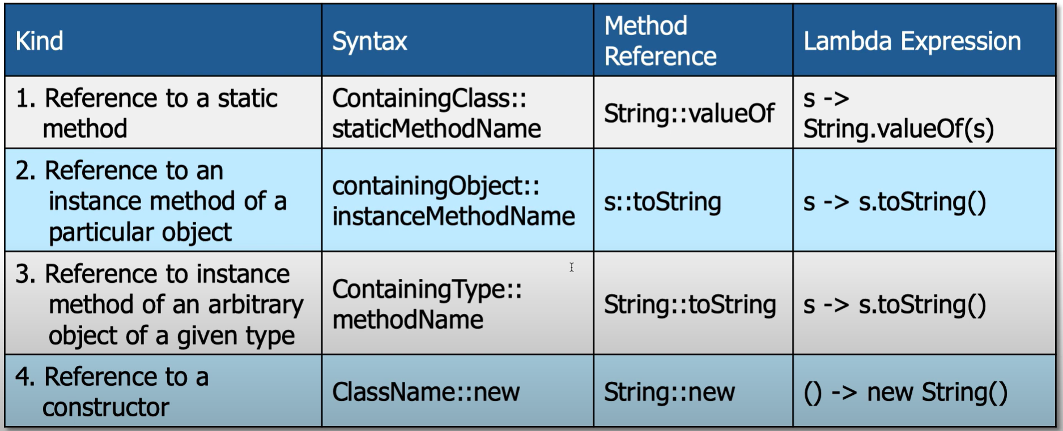
Some Examples

Slide 10
Where To Use Method Reference ?
Whenever we have a Lambda Expression which only does one thing and that is calling a method, there we can use Method References.
Using Lambda:
Function <String,String> fn=str->str.toUpperCase();
Using Method Reference:
Function <String,String> fn=String::toUpperCase();

Slide 11
Where We Cannot Use Method Reference ?
Whenever we are adding our own logic to a Lambda Expression then we cannot use Method References even if we are calling a method.
Using Lambda:
Predicate <Emp> p=e->e.getSal()>=20000;
Using Method Reference:
Not Possible

Slide 12
Using Method Reference For Calling static Method
import java.util.function.Function;
class Demo
{
public static void main(String[] args)
{
//Calling parseInt() method using lambda
Function<String, Integer>f1=(String s) -> Integer.parseInt(s);
System.out.println(f1.apply("12"));
//Calling parseInt() method using method reference
Function<String, Integer>f2= Integer::parseInt;
System.out.println(f2.apply("12"));
}
}

Slide 13
Exercise
Using Method Reference , write code to add two integers passed as command line arguments

Slide 14
Solution
import java.util.function.Function;
public class MethodRefDemo {
public static void main(String[] args) {
Function<String,Integer> fn=Integer::parseInt;
int c=fn.apply(args[0])+fn.apply(args[1]);
System.out.println("The sum of "+args[0]+" and "+args[1]+" is "+c);
}
}

Slide 15
Using Method Reference For Calling instance Method
import java.util.function.Supplier;
class Company
{
String name;
public Company(String name)
{
this.name = name;
}
public String getName()
{
return name;
}
}

Slide 16
Using Method Reference For Calling instance Method
class Demo
{
public static void main(String[] args)
{
Company c = new Company("Oracle");
//Calling getName() of c using lambda
Supplier<String> s1 = () -> c.getName();
System.out.println(s1.get());
//Calling getName() of c using method reference
Supplier<String> s2 = c::getName;
System.out.println(s2.get());
}
}

Slide 17
Using Method Reference For Calling instance Method For arbitary object
import java.util.function.Function;
class Demo
{
public static void main(String[] args)
{
//Calling toLowerCase() method using lambda
Function<String, String> s1= (String s) -> s.toLowerCase();
System.out.println(s1.apply("JAVA"));
//Calling toLowerCase() method using method reference
Function<String, String> s2 = String::toLowerCase;
System.out.println(s2.apply("JAVA"));
}
}

Slide 18
Exercise
Suppose , we have an array of Strings as shown below:
String[] sports={"cricket","snooker","football","volleyball","rugby","hockey"};
How will you sort this array ?
Ans: By using the method Arrays.sort() , having the following prototype:
public static void sort(String[ ],Comparator)

Slide 19
Approach 1
String[] sports={"cricket","snooker","football","volleyball","rugby","hockey"};
Arrays.sort(sports,new Comparator<String>(){
@Override
public int compare(String t, String t1) {
return t.compareTo(t1);
}
});

Slide 20
Approach 2
String[] sports={"cricket","snooker","football","volleyball","rugby","hockey"};
Arrays.sort(sports,(s,t)->s.compareTo(t));

Slide 21
Approach 3
String[] sports={"cricket","snooker","football","volleyball","rugby","hockey"};
Arrays.sort(sports,String::compareTo);

Slide 22
Constructor Reference
Suppose , we have a lambda expression like the following:
(args) -> new ClassName(args)
The only thing this lambda expression does is to create and return a new object.
We can reduce it by referencing a constructor of the class with the keyword new as shown below:
ClassName::new

Slide 23
Calling No Arg Constructor
How will you call a non parameterized constructor which creates and returns object of a particular class using Lambda Expression or Constructor Reference?
For example , how to write the following statement using Lambda Expression ?
List<String> myList = new ArrayList<String>();
The answer is using Supplier interface

Slide 24
Calling No Arg Constructor
Using a lambda expression
Supplier<List<String>> s = () -> new ArrayList<String>();
List<String> myList = s.get();
Using a constructor reference
Supplier<List<String>> s = ArrayList<String>::new;
List<String> myList = s.get();

Slide 25
Calling Single Arg Constructor
How will you call a single parameterized constructor which creates and returns object of a particular class using Lambda Expression or Constructor Reference?
For example , how to write the following statement using Lambda Expression ?
int n=100;
Integer obj=new Integer(n);
The answer is using Function interface

Slide 26
Calling Single Arg Constructor
Using a lambda expression
Function<Integer, Integer> f = s -> new Integer(s);
int n=100;
Integer obj = f.apply(n);
Using a constructor reference
Function<Integer, Integer> f = Integer::new;
int n=100;
Integer obj = f.apply(n);

Slide 27
Creating Scanner Object Using Constructor Reference
Using a constructor reference
Function<InputStream,Scanner> fn=Scanner::new;
Scanner kb=fn.apply(System.in);

Slide 28
Calling Double Parametrized Constructor
For this , we need to use the BiFunction interface.
It is a functional interface; which takes two arguments and returns an object.
@FunctionalInterface
public interface BiFunction<T, U, R> {
R apply(T t, U u);
}

Slide 29
Creating A HashMap
Create a HashMap with initial capacity of 20 and load factor of 0.8 , using constructor reference
Solution
BiFunction <Integer,Float,HashMap<Integer,String>> bif=HashMap::new;
HashMap <Integer,String>hm=bif.apply(20, 0.8f);

Slide 30
Lambdas And Local Variables
Local Variables: A variable is called a local variable if it is declared inside a method body or in a method’s parameter list.
Restrictions applied on Lambda w.r.t. Local Variables:
We cannot have a variable declared in lambda argument or lambda method body whose name matches with the name of a local variable.
We cannot modify the value of a local variable from the body of a lambda method . That means that even though the local variable is not explicitly declared as final , but still it behaves like a final variable in lambda . This behavior is called Effectively Final.

Slide 31
Rule 1 Getting Violated
int first = 0; Comparator<String> comp = (first, second) -> first.length() - second.length();
This lambda expression implements the compare() method of the Comparator functional interface but that will result in an error .
This is because the parameter used with in the lambda expression has the same name as the local variable called first already defined.
Thus this statement results in compile time error “Lambda expression’s parameter first cannot redeclare another local variable defined in an enclosing scope”.

Slide 32
Rule 2 Getting Violated
interface TestInterface{
public int sum(int a,int b);
}
class Test{
public static void main(String [] args){
int n=7;
TestInterface tif=(x,y)->{
n=x+y;
return n;
};
}
}
In the above example with in the lambda expression block there is
an attempt to modify the value of a local variable from an enclosing scope
that results in an error “Local variable n defined in an
enclosing scope must be final or effectively final”.
However this restriction does not apply to instance variables or static
variables

Slide 33
Using this And super In Lambda
Since lambda expressions don’t introduce a new scope so using this keyword and super keyword with in a lambda refers to the same object that has invoked the method where the lambda expression resides.
For Example:
In the above code , the expression this.toString() calls the toString() method of the Application object, and not the Runnable instance.
class Application { public void doWork() { Runnable runner = () -> { ...; System.out.println(this.toString()); ... }; ... } }

